Slide 1
PIE CHARTs_ultimate revision

Slide 2
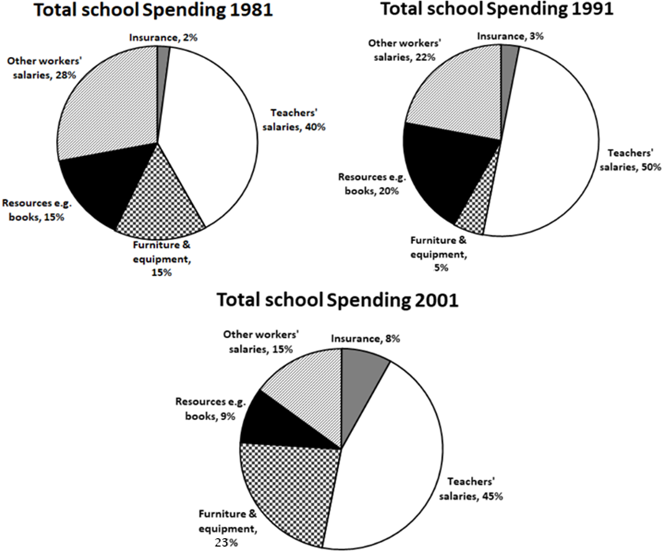
Question:
The three pie charts below show the changes in annual spending by a particular UK school in 1981, 1991 and 2001.
Notes:
Overview: largest – smallest - nên viết thành 2 câu – on the other hand/in contrast. Nếu có report trend thì chỉ có của insurance/other worker salary là significant;

Slide 3
Grammar: tìm danh từ quan trọng nhất => verb
Changes => how … changed
Vocab: annual spending
=> budget/expenditure
Specify: expenditure on/budget for 5 expenses/sectors.
Question:
The three pie charts below show the changes in annual spending by a particular UK school in 1981, 1991 and 2001.
Intro: The given three pie charts illustrate how the annual spending on five different expenses of a particular UK school shifted in the year 1981, 1991 and 2001.
Notes:
The amount of money spent on …

Slide 4
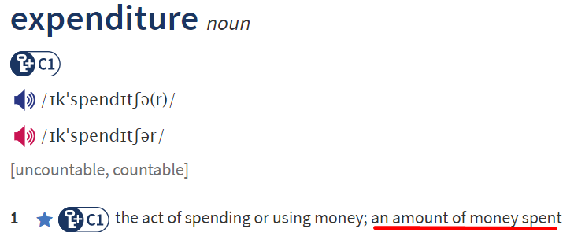
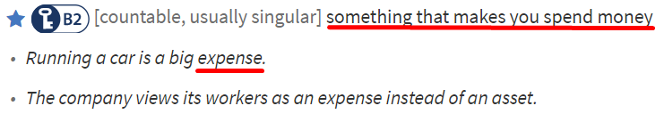
Overview:
***subjects
The percentage of [type]
The data for [type]
The amount of money spent on [type]
Spending on | expenditure on | the budget for
As can be seen from the charts, payments for salaries were the biggest expenses, while the lowest amount of money was allocated to insurance. It is also apparent that spending on teachers’ salaries, facilities and resources fluctuated, whereas that on other workers’ earnings slumped over the period.
Notes:
While on 1 2 3 fluctuated, that on … registered a significant decrease

Slide 5
CÁCH CHIA THÔNG TIN THÂN BÀI – DYNAMIC PIE
Chia theo đối tượng (bổ ngang)
Body 1: những loại to nhất (order).
Câu 1: static (năm đầu) – loại lớn nhất
Câu 2: static (năm đầu) – loại được nhóm => so sánh
Câu 3: miêu tả trends của các loại trong đoạn.
Body 2: những loại còn lại.
Các câu trong đoạn: miêu tả số + trend từng loại theo thời gian (có sử dụng từ nối).

Slide 6
Khổ 1:
Teachers’ salaries; Other workers’ salaries
Khổ 2:
Insurance;
Furniture & Equipment;
Resources
Notes:
Thay vì nói: … accounted for …% of the total school spending

Slide 7
Khổ 1: teachers & other salaries
S1: (start from the highest)
In [1st year], [the data for type] was/stood at/began at …
S2: (compare)
This figure was … higher than that/those for [type]
S3: trend – highest
S4: trend – the other type
Notes:
Khổ 1: trend của converts -> CDs (có thể bỏ qua trend của CDs năm thứ 2)

Slide 8
CÁC TỪ NỐI

Slide 9
Từ nối các giai đoạn trong 1 câu – trend 3 điểm
And then/ But then
10 years later, this figure rose slightly and reached a peak of 50%,
and/but then it experienced a slight fall to 45% in 2001.
Before (after)
10 years later, this figure rose slightly and reached a peak of 50%,
before it experienced a slight fall to 45% in 2001.
At which point
10 years later, this figure rose slightly and reached a peak of 50%,
at which point it experienced a slight fall
to 45% in 2001.

Slide 10
Body 1:
In 1981, the highest amount of money went on teachers’ salaries, at 40%, followed by other workers’ salaries at 28%. 10 years later, the budget for “teacher salaries” increased and reached a peak of a half before falling to 45% in 2001. Meanwhile, expenditure on “other workers’ salaries” halved to 15% between 1981 and 2001.

Slide 11
Khổ 2: facilities – resources - insurance
S1&3: [cohesive devices] – trend: facilities - resources
S2: [cohesive devices] – trend: resources
Notes:
Khổ 1: trend của converts -> CDs (có thể bỏ qua trend của CDs năm thứ 2)

